Slide 1
1-7 Perimeter, Circumference & Area M11.B.2 2.5.11.B Objectives: 1) Find the perimeters of rectangles and squares, and circumferences of circles

Slide 2
Vocabulary
Perimeter (P) – the sum of the lengths of a figure’s sides
(C)- called circumference in circles
**The distance AROUND a figure
**Record in single units inches, feet, yards
Area (A)- The number of square units a figure encloses
**Record in squared units inches squared, feet squared

Slide 3
Perimeter & Area
Square
Rectangle

Slide 4
Perimeter & Area
Circle

Slide 5
Example 1: Real World Connection
Margaret’s garden is a square 12 ft. on each side. She wants a 1 ft. wide path around the entire garden. What will the outside perimeter of the path be?

Slide 6
Example 2
Suppose you want to frame a picture that is 7 in. by 8 in. with a ½ inch wide frame. Find the perimeter of the picture. Find the perimeter of the outside edge of the frame.

Slide 7
Example 3: Finding Circumference
Circle G has a radius of 6.5 cm. Find the circumference of circle G in terms of π. Then find the circumference to the nearest tenth.

Slide 8
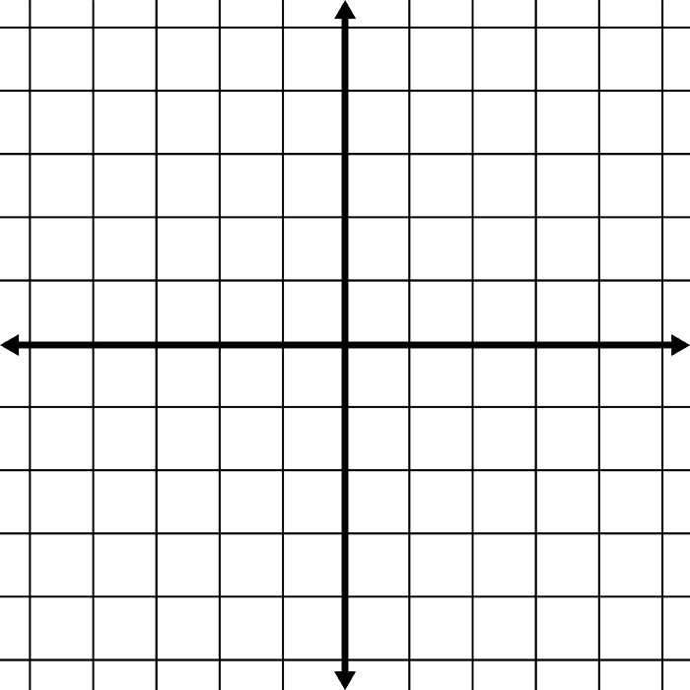
Example 4: Finding Perimeter in the Coordinate Plane
Graph triangle ABC with vertices A(-1, -2), B(5, -2), and C(5, 6). Find the perimeter of ABC.

Slide 9
Example 5: Finding Area of a Rectangle
To make a project, you need a rectangular piece of fabric 36 inches wide and 4 feet long. How many square feet of fabric do you need? CAUTION: Make sure all units are the same!!

Slide 10
Example 6
You are designing a banner that will be 4 ft wide and 7 yd high. How much material do you need?

Slide 11
Example 7: Finding Area of a Circle
Find the area of circle B in terms of π. Then find the area to the nearest tenth.
12 yd
B

Slide 12
Postulates
Postulate 1-9
Postulate 1-10
If two figures are congruent, then their areas are equal.
The area of a region is the sum of the areas of its nonoverlapping parts.

Slide 13
Example : Finding Area of an Irregular Figure

